Slide 1


OPTIMIZATION CNN
Supervised by: A.Prof.Ahmed Magdy
Dr.Iman Mostafa
Presented by : Mohamed Amir Ghanam

Slide 2

Arowwai Industries
OUTLINE
Deep Learning
Convolutional Neural Network
problem space
Our work

Slide 3

DEEP LEARNING
Deep Learning is a new area of Machine Learning research, which has been introduced with the objective of moving Machine Learning closer to one of its original
goals to artificial Intelligence.
The main aim of this learning is to help to achieve and understanding the data such as images, text and video to recognize them.

Slide 4
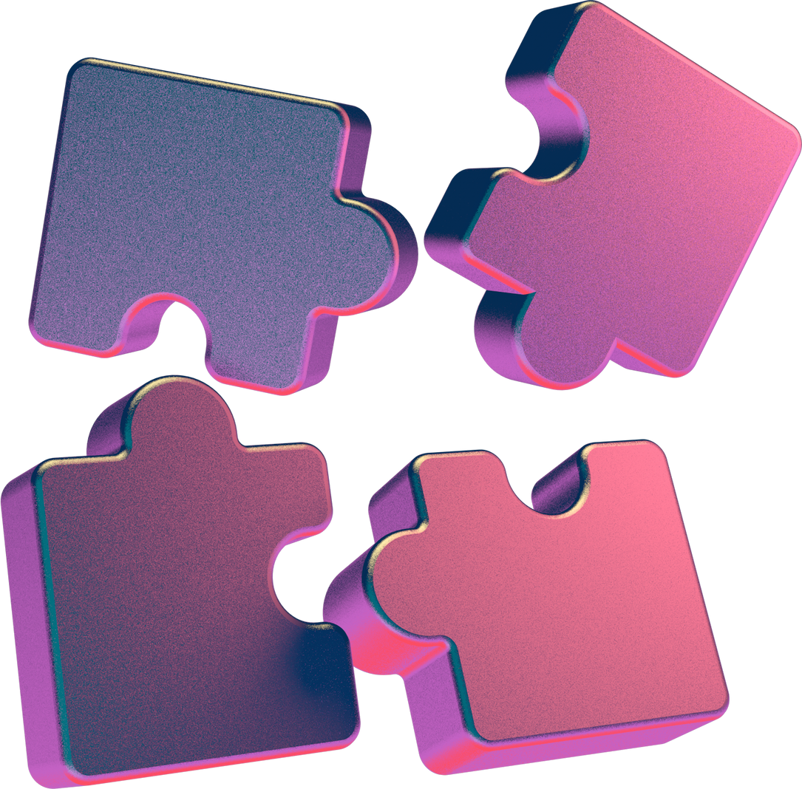
CONVOLUTIONAL NEURAL NETWORK
Convolutional Neural Networks
Most of large companies uses this kind of deep learning at the core of their service. Facebook uses neural nets for their automatic tagging algorithms, Google for their photo search, Amazon for their product recommendations, and Instagram for their search infrastructure.
However, use case of these networks is for image processing.

Slide 5

PROBLEM SPACE
When a computer sees an image (takes an image as input), it will see an array of pixel values. Depending on the resolution and size of the image, let’s say we have a color image in JPG form and its size is 480 x 480. The representative array will be 480 x 480 x 3. Each of these numbers is given a value from 0 to 255 which describes the pixel intensity at
that point
The computer is able perform image classification by looking for low level features such as edges and curves, and then building up to more abstract concepts through a series of convolutional layers.

Slide 6
Arowwai Industries
OUR WORK
Dataset consist of three section :
1- Training consist of:
8005
val section consist of:
1-val consist of:
2045
www.reallygreatsite.com

Slide 7
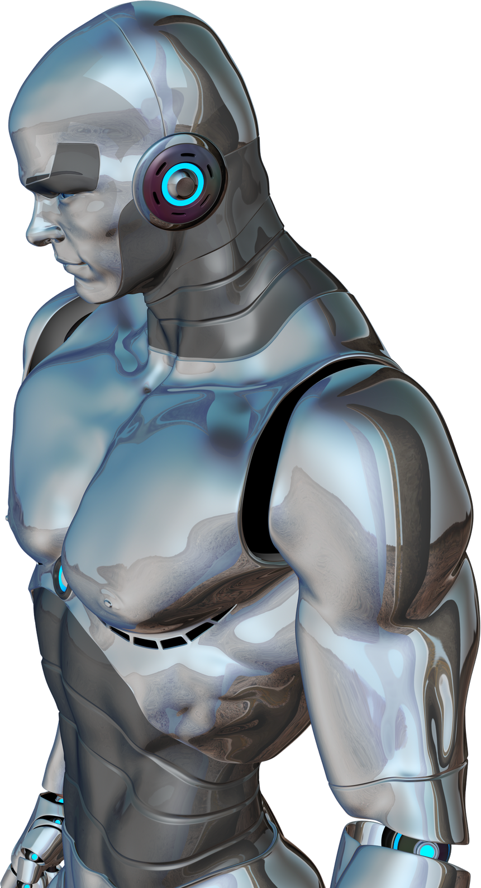
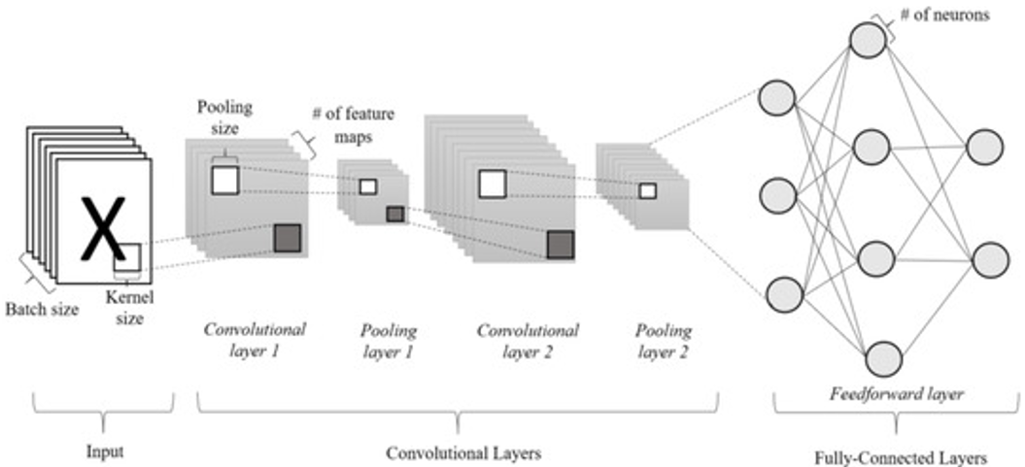
DEEP LEARNING

Slide 8
THANK YOU!

